Slide 1
Figures JICNA – 2016
Fatima Y Ismail
Ali Fatemi
Michael Johnston

Slide 2
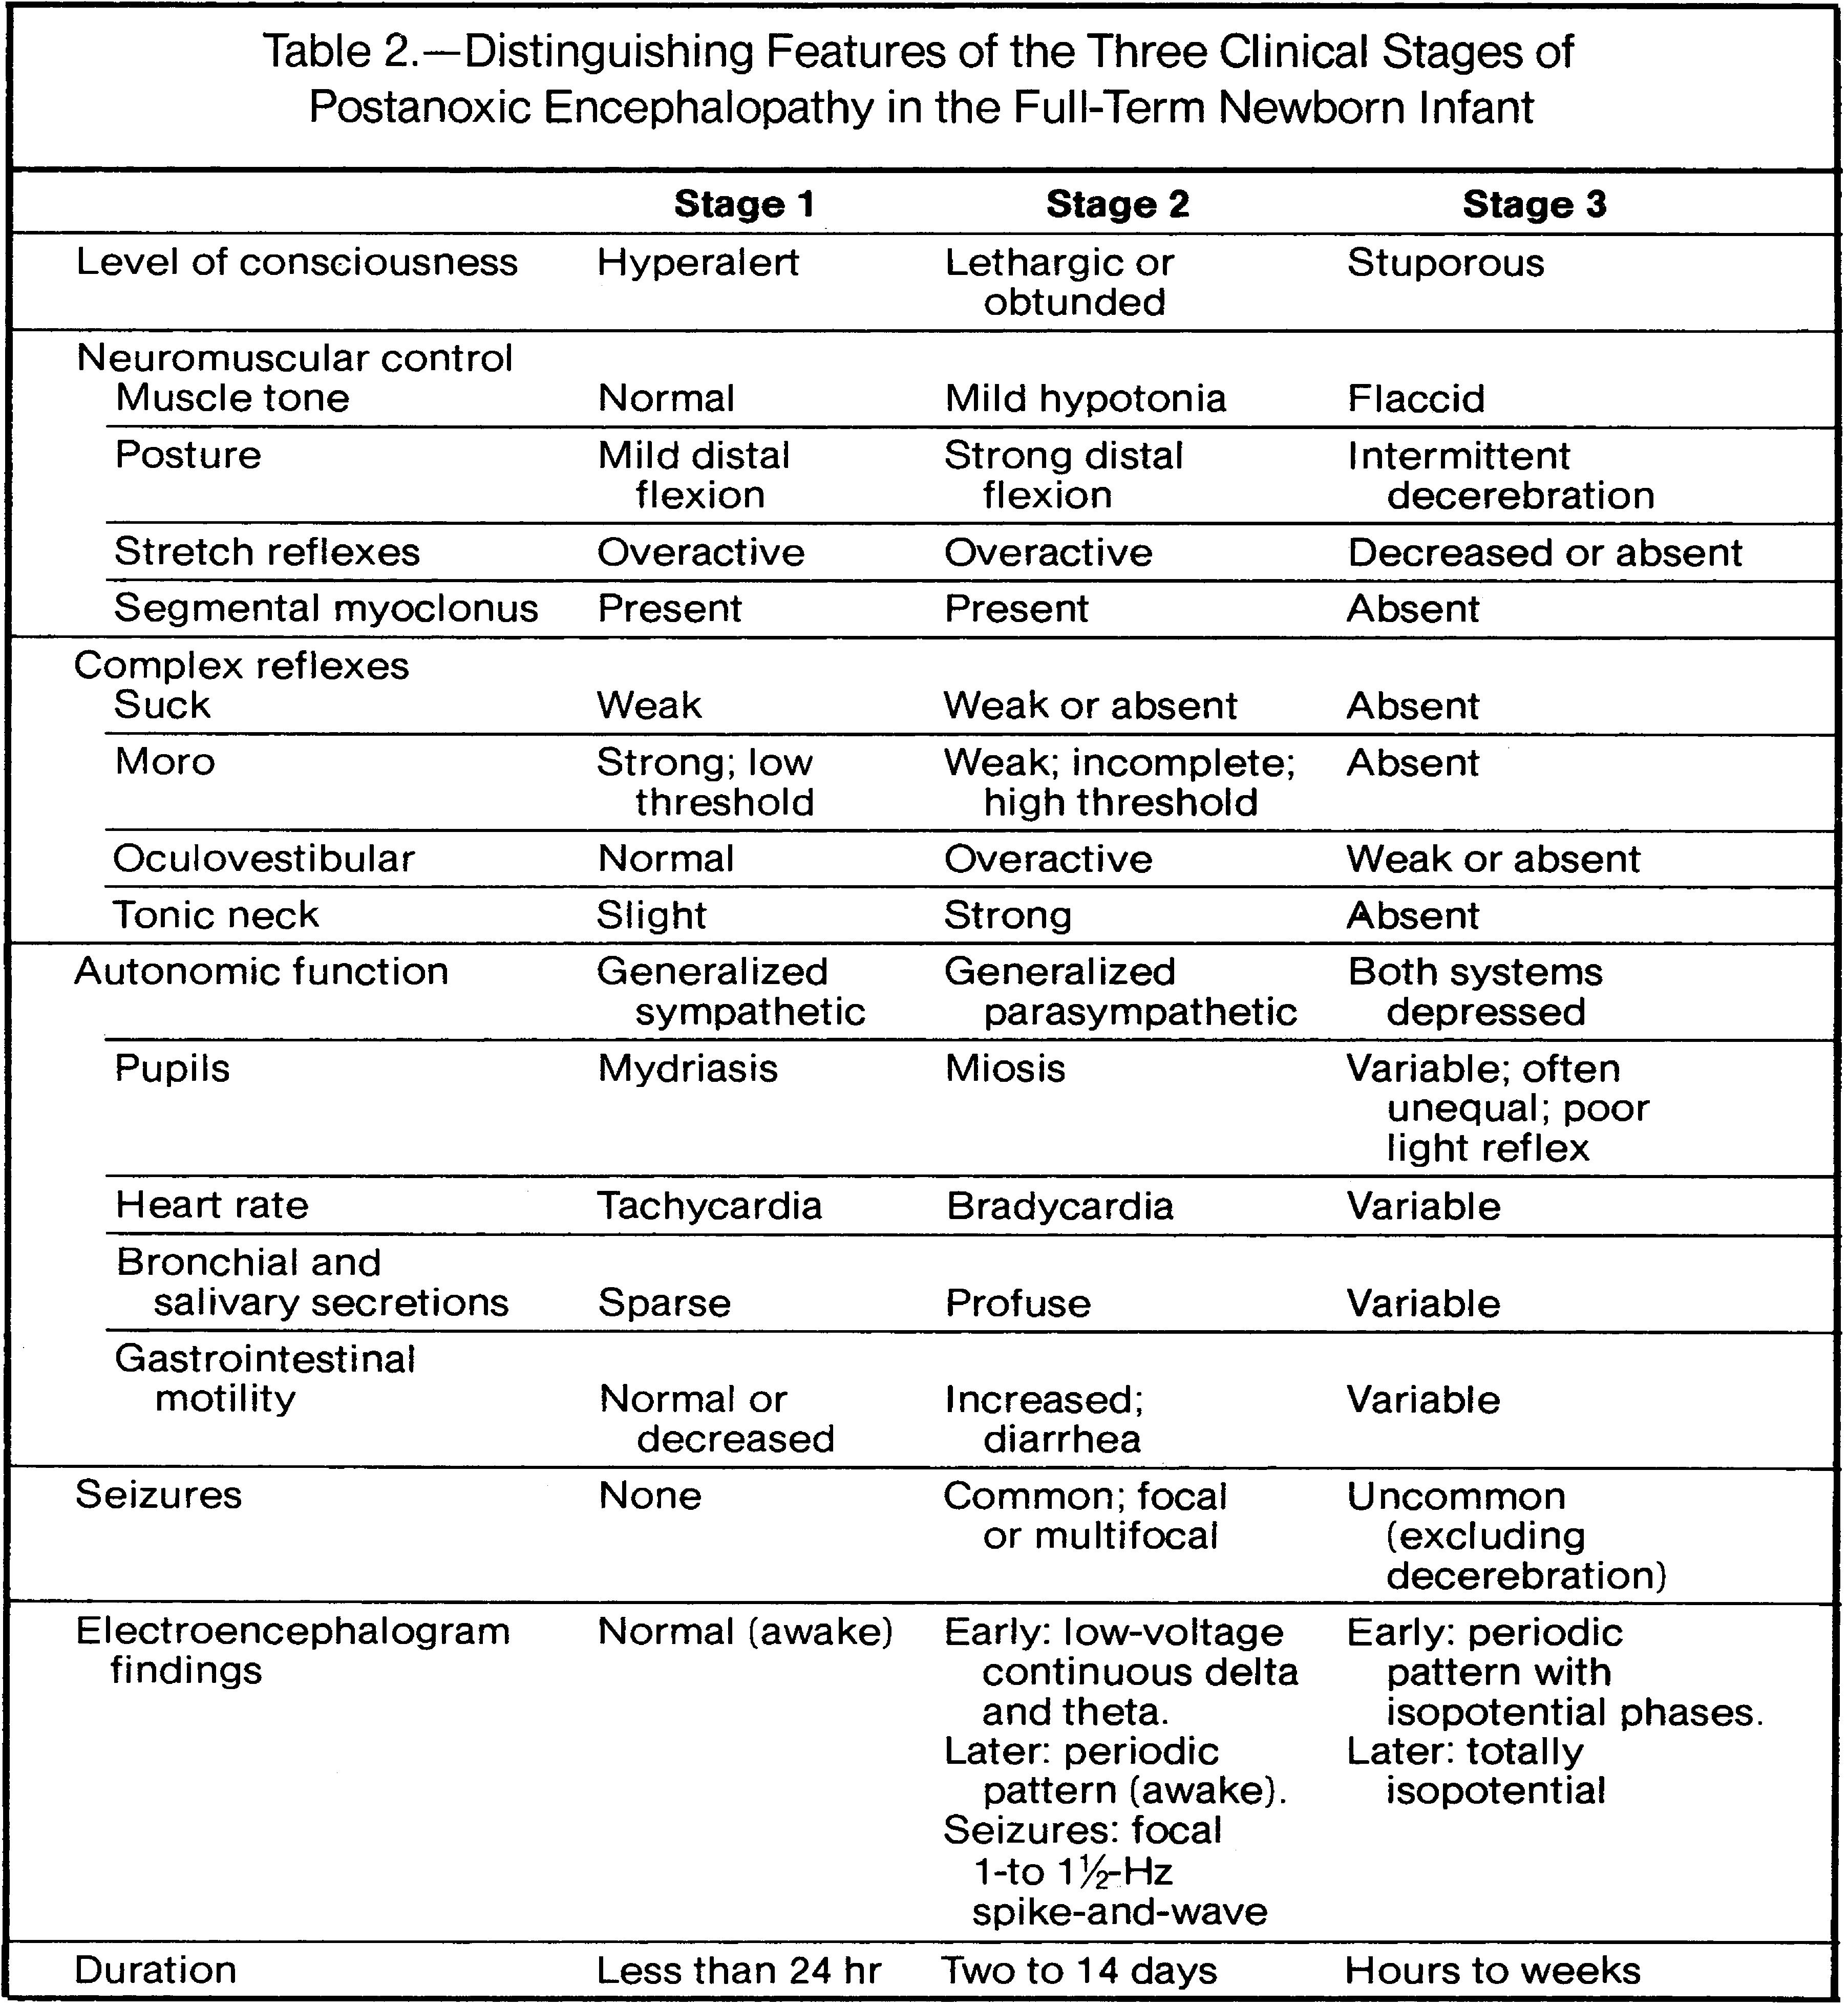
Figure (1)

Slide 3
HII
Primary
Energy Failure
Latent Period
Secondary
Energy Failure
Delayed
CNS injury
Therapeutic Window for hypothermia
Minutes
Reperfusion injury
6 – 72 Hours
Days to weeks
Ischemia and Hypoxia
⬇
ATP depletion and
dysfunction of NA/K pump
⬇
Increase intracellular Na leading to Cytotoxic edema
⬇
intracellular Ca2+
⬇
Glutamate toxicity (AMPA, NMDA overactivation) and Failure to reuptake Glutamate from the synapse
⬇
Necrosis and apoptosis
Mitochondrial dysfunction
⬇
Inflammation and Microglial activation
⬇
Decrease protein synthesis and loss of neurotrophic factors
⬇
Necrosis and apoptosis
Wallerian Degeneration
Hypomyelination
Abnormal vascular and neuronal remodeling
Figure (2)

Slide 4
DWI pseudo-normalizes)
T1/T2 abnormal, progressive white matter damage
MRS lactate⬆
NAA ⬇
DWI abnormal (hyperintense)
T1/T2 Normal
MRS lactate⬆
NAA⬇
DWI abnormal (hyperintense)
T1/T2 abnormal
MRS: lactate ⬆
NAA ⬇
DWI (pseudo-normalizes)
T1/T2 abnormal
MRS lactate ⬆
NAA⬇
DWI abnormal
(hyperintense)
6 hrs
1-2 days
4-7 days
7-10 days
> 10 days
HII
Figure (3)

